Slide 1


POINTERS
By:-
Sri Harsha.N

Slide 2
CONTENTS
What is a pointer?
Declaration, assignment, dereferncing a pointer
Pointer operators
Different types of pointers
Operations on pointers
Pointers to Functions
Function pointer
Pointer to array
One Dimensional array
Two dimensional Array
Array of pointers
Pointer to array

Slide 3
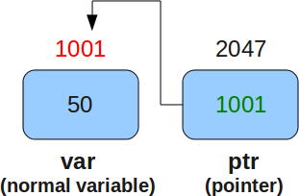
What is a Pointer?
Pointer is a variable which holds the address of another variable and having dereferncing properties.

Slide 4

Declaration Of a Pointer
Like all other variable pointer variable is also to be declared before being used.
The general syntax of declaration is :
data_type * p_name;
Some examples are
int *iptr;
char *cptr;
double *dptr;
Pointers are variables so compliler will reserve space for them and they also have some address.Pointers irrespective of their data type generally occupies same space.

Slide 5
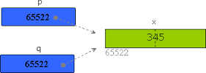
Assigning to a pointer
Generally global and local static pointers automatically initialized to NULL, when we declare a pointer variable it contains garbage value i.e it may point to any where.So we have to assign an address before using it in the program.
int *iptr;
int a = 20;
iptr = &a; &iptr = 2000 &a = 1000
Assigning a pointer to another pointer:-
It is also possible to assign thre value of one pointer variable to other, provided their base type is same.
int *p;
int *q ;
int x =345;
p = &x;
p = q;
1000
20

Slide 6
Dereferencing a pointer variable
We can also access a variable indirectly using pointers. For this we will use indirection operator (*).
By placing indirection operator before a pointer variable we can access the variable.
Example:-
int main(void)
{
int a = 10;
int *iptr = &a;
*iptr = 20;
printf(“%d %d\n”,a,*iptr);
return 0;
}

Slide 7
Pointer vs Constant
There are mainly three types of there in this.They are
1.base_type * const ptr_name
2.const base_type * ptr_name
3.const base_type * const ptr_name
Example:-
int *const p;
const int *p;
const int * const p;

Slide 8
Pointer Arithmetic
There are only some arithmetic operations are valid on pointers.They are
(i) Addition of an integer to a pointer and increment operation.
(ii)Subtraction of an integer from a pointer and decrement operation.
(iii)subtraction of a pointer from another pointer.
All pointer arithmetic operations are based upon their base type only.
Example:-
int i = 0;
int *ptr = &i;
ptr+1;
ptr++;
ptr--;
ptr-1;

Slide 9
Pointer operators
Mainly two operators we have to consider while using pointers. They are
1. Address operator (&)
2. Dereferncing operator (*)
Address operator(&) :-
The address operator gives the address of variable when placed before it. The format specifier “ %p “ is used to print the address.These address may be different each time when you run your program, it depends on which part of memory is allocated for that variable.
The address operator cannot be used on constant values, expressions and register variables.
Ex :-
&1;
&reg_var;
&(a+b);

Slide 10
Contd....
Dereferencing operator (*) :-
It is used for indirectly accessing of a variable by using pointers.
Example:-
char *p1 ;
1200 2622 2623 2624 2625 2626
p1
int *p2;
2106 2120 2121 2122 2123 2124
p2
2622
's' | 'r' | 'i'
2120
ff | 32 | 21 | 21

Slide 11

Precendence of dereferencing and Increment/decreement operator
The precedence of '*' and increment/decrement operators is same and associativity is from right to left. Mainly we have four types of pointers expressions with these operators. They are
base_type * ptr_name;
1. *ptr++
2. *++ptr
3. ++*ptr
4. (*ptr)++
Example:-
int x = 25;
int *ptr = &x;
2000 2004
ptr
1. x = *ptr++;
value of x = 21 pointer value = 2004 ptr 2000
21 | 06
21 | 06

Slide 12
Contd.....
2. x = ++*ptr;
value of x = 22 address in pointer = 2000
2000 2004
ptr
3. x = (*ptr)++;
value of x = 22 address in pointer value = 2000 ptr 2000 2004
ptr
4. x = *++ptr
value of x = 06 address in ptr = 2004
ptr
22 | 06
22 | 06
22 | 06
21 | 06

Slide 13
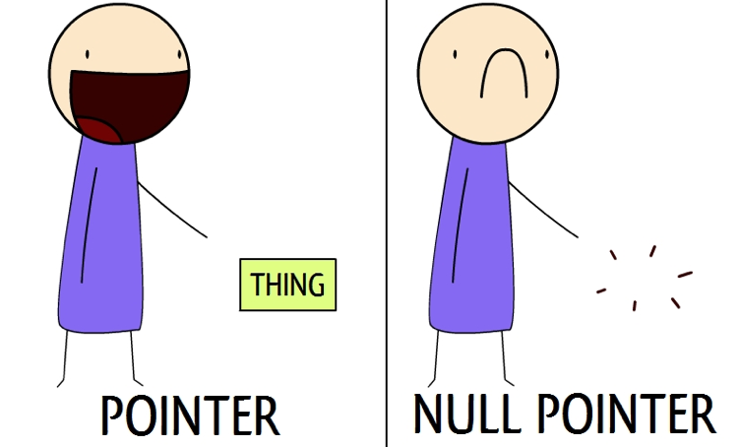
Types of Pointers
There are mainly four pointers are there .They are
1.Null pointer
2.Wild pointer
3.Dangling pointer
4.Void pointer
Null pointer:-
A pointer whose value is NULL and is not pointing to any thing that can be accessed.

Slide 14
Contd...
Wild pointer:-
Unintialized pointers in a function block are called wild pointers.
Dangling pointer:-
It is a pointer pointing to dyanamic memory which is deallocated.If you dereference this the output is unpredictable.
Void pointer:-
Any pointer to an object may be converted to type void * without loss of information.If the result is converted back to original type ,the original pointer is recovered.

Slide 15
Pointer and Arrays
The elements of an array are stored in contiguos memory locations.
Example:-
int a[5];
When the name of an array used in any expression, it implicitly converted into first element of the array. The are two exceptions to this rule are when array name is used as an operand of sizeof and & operator.
We can access the array elements using pointer expressions.
Pointer to 1-D array :-
Let's take a pointer variable ptr and initialize with address of starting element of an array arr.
Ex:-
int *ptr;
ptr = arr;
Illegal operations on array name:-
arr = &num;
arr++;
arr = arr – 1;

Slide 16
How to access using pointers?
On applying pointer arithmetic and dereferencing we can see that the expression ptr+i denotes the address of
i th elemnet of an array and the expression *(ptr+i) denotes the value of i th element of an array.
Difference between name of an array and a pointer variable
Array:-
arr = &num;
arr++;
arr = arr-1;
Pointer:-
ptr = &num;
ptr++;
ptr = ptr-1;

Slide 17
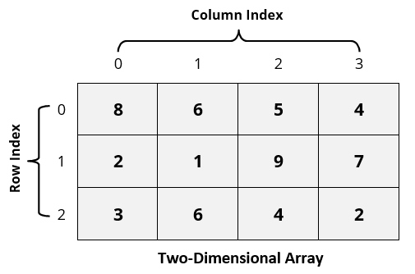
Contd...
Pointer to 2-D array :-
In a two dimensional array, we can access each element by using two subscripts, where first subscript represents row number and second represents column nuumber.
Example :-
int a[3][4] = {{8,6,5,4},{2,1,9,7},{3,6,4,2}};

Slide 18

Contd....
How to access two dimensional array elements?
Suppose if we have an array arr[10][20],you want to access ith row and jth column element in the array using pointer.
How to print the two dimensional array elements using pointer?

Slide 19
Array of Pointers
We can declare an array that contains pointers as its elements.Every element of this array that can hold address of any variable of appropriate type.
The syntax for declaring array of pointers is:-
datatype * arr_name [size];
Example:-
int main(void)
{
int *arr[2];
int a =5;
int b= 3;
arr[0] = &a;
arr[1] = &b;
printf(“%d %d\n”,a,*arr[0]);
printf(“%d %d\n”,b,*arr[1]);
return 0;
}

Slide 20
Pointer to an array
We can declare a pointer that pointing to whole array instead of only one element of an array.
Syntax for declaring a pointer to an array:-
data_type (* ptr_name)[size];
Example:-
int main(void)
{
int arr[2] = {1,2};
int (*p)[2] = &arr;
printf(“%d %d\n”,sizeof(arr),sizeof(p));
return 0;
}
How to print 1-d array elements using pointer to an array?

Slide 21
Pointers to Functions
Arguements can be passed in two ways to a function
i.) call by value
ii.) call by reference
Call by value:-
In call by value ,only values of the arguements are sent to the function.In this method if any changes made to the formal parameters do not change actual arguement.
Call by reference:-
In call by refernce address of that variables are sent to that calling function.In this if any changes made to that formal parameters change the actual arguements.This can by achieved by using pointers.

Slide 22
Function pointer
In C, like normal data pointers (int *, char *, etc), we can have pointers to functions.
Syntax for declaring a function pointer is :
data_type (*fun_name)( arguements1,arguement2, ...);
Points to remember while using function pointer are :-
1.Unlike normal pointers, a function pointer points to code, not data. Typically a function pointer stores the start of executable code.
2.we do not allocate de-allocate memory using function pointers.
3.Like normal data pointers, a function pointer can be passed as an argument and can also be returned from a function.
4.We can have an array of function pointers.
5.Function pointer can be used in place of switch case.

Slide 23
Complicated declarations
It is important to know how to understand complicate ddiclarations,and, sometimes it is necessary to use these in our programs.
Example:-
1. char **ptr;
2. int (*ptr)[21];
3. void *fun(void,void);
4.void (*fun)(int , char);
5.char (*(*x())[])();
6.char (*(*x[3])())[5];

Slide 24


Slide 25


